Slide 1

Time Horizon Weather Prediction Machine Learning Model
A Comparative Analysis of ML Techniques for Multi-Step Forecasting
Author: Sehen Elzem Altun
Faculty of Computer Science and Engineering, University of Bologna

Slide 2


The Evolution of Weather Forecasting
Traditional NWP
Numerical Weather Prediction (NWP) relies on fluid dynamics and complex physical principles. It requires supercomputers and extreme expertise in atmospheric physics.
The ML Paradigm
Machine Learning models learn patterns from historical data without solving physical equations. This offers a computationally efficient alternative for local forecasting.

Slide 3






Core Research Focus
Multi-Horizon
Multi-Output
Comparison
Examining performance degradation across 3-day, 5-day, and 7-day future time frames.
Simultaneously predicting both Daily Maximum and Minimum air temperatures.
Evaluating Linear Regression, Random Forest, SVR, and Multi-Layer Perceptrons.

Slide 4
Methodological Framework: CRISP-DM
Data Understanding: Analysis of meteorological patterns in Cesena, Italy (2015-2025).
Data Preparation: Aggregation of 6-hour measurements into daily max/min features.
Modeling: Implementation of four regression architectures with hyperparameter tuning.
Evaluation: Testing on unseen 2023-2025 data using RMSE, MAE, and R² metrics.

Slide 5

Study Area: Cesena, Italy
Coordinates: 44.18° N, 12.21° E
Period: 2015 – 2025
Source: Open-Meteo Platform
The dataset includes 16,072 observations of variables like humidity, pressure, cloud cover, and wind speed, aggregated into a 4,018-sample daily dataset.

Slide 6
Feature Engineering & Reduction
Multicollinearity Removal
Temporal Decomposition
Highly collinear features (>0.9 correlation) were removed to prevent instability:
DateTime stamps were split into discrete numerical features to capture seasonality:
Temp vs Apparent Temp (0.991)
Hour, Month, Year, Day of Week, Day of Month.
Surface Pressure vs MSL Pressure (1.000)
Standardization: All features centered at zero mean with unit variance for stable convergence.
Soil Temp vs Apparent Temp (0.980)

Slide 7

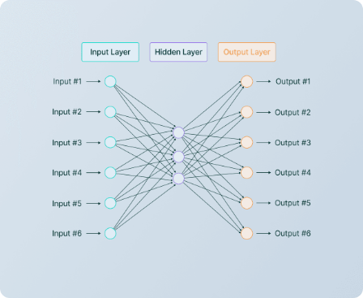
Evaluated Architectures
Linear Regression: Statistical baseline model.
Random Forest: Optimized with 200 trees and max depth of 20 via Grid Search.
SVR: RBF kernel with C=100 and Gamma=0.1.
MLP (Neural Network): (100, 50) hidden layer config, ReLU activation, L2 regularization (0.001).

Slide 8




Criteria for Success
Root Mean Square Error
Coefficient of Determination
Metrics are averaged across both Maximum and Minimum temperature outputs.

Slide 9
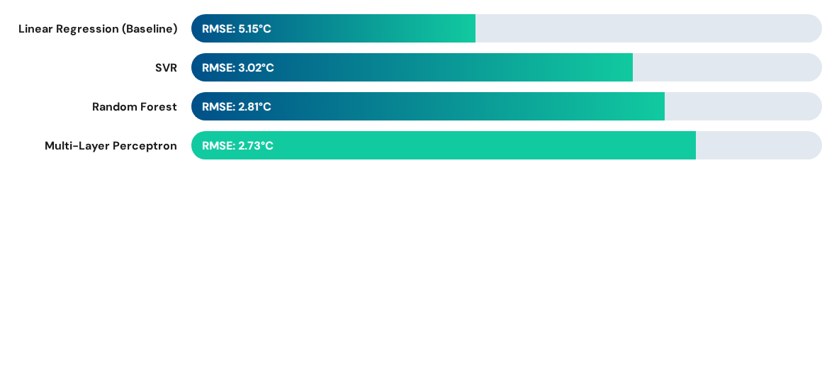
Same-Day Prediction Performance
MLP achieved a 47% reduction in error compared to the linear baseline.

Slide 10
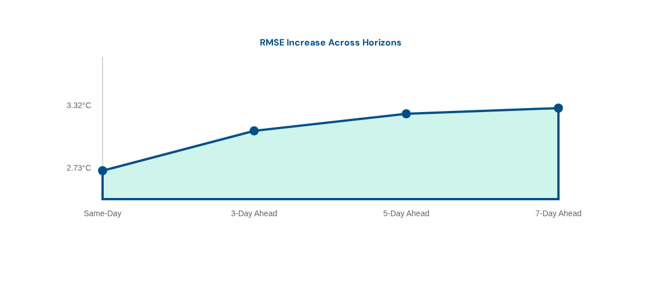
Multi-Step Horizon Forecasting (MLP)
Error increase diminishes at longer horizons as models converge toward climatological means.

Slide 11
Key Conclusions
87%
3.3
VARIANCE EXPLAINED (R²)
MAX RMSE FOR 5-DAY
Non-Linear Superiority: Neural networks are exceptionally well-suited for correlated multi-output tasks.
Reliability Window: Accurate forecasting is highly viable within a 3-5 day window (RMSE < 3.3°C).
Efficiency: Batch learning with structured features avoids the computational complexity of recurrent models.

Slide 12

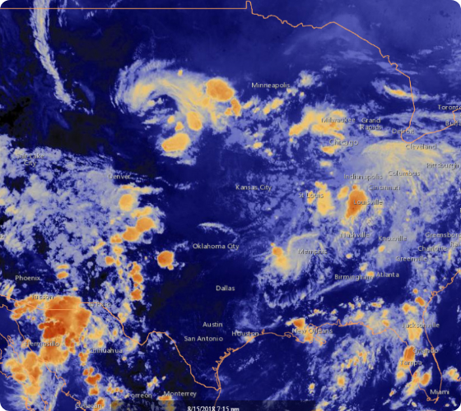
Thank You
Questions & Discussion
Contact: sehenelzem.altun@studio.unibo.it
University of Bologna | 2025

Slide 13




Image Sources
https://static.vecteezy.com/system/resources/previews/060/763/021/non_2x/elegant-abstract-data-analysis-chart-and-graph-transparent-background-professional-free-png.png
Source: www.vecteezy.com
https://upload.wikimedia.org/wikipedia/commons/1/1b/Cesena%2C_Emilia-Romagna%2C_Italy.jpg
Source: commons.wikimedia.org
https://framerusercontent.com/images/aZW0MrFDu8LFrU2iSYHOIpI8E.png
Source: www.v7labs.com
https://www.noaa.gov/sites/default/files/styles/landscape_width_1275/public/legacy/image/2019/Jun/weather_image.jpg
Source: www.noaa.gov

